Slide 1
Chapter 3
RELATIONAL ALGEBRA AND CALCULUS

Slide 2
Introduction
A data model must include a set of operations to manipulate the database, in addition to the data model's concepts for defining database structure and constraints.
The basic set of operations for the relational model is the relational algebra.
These operations enable a user to specify basic retrieval requests.
The result of a retrieval is a new relation, which may have been formed from one or more relations
A sequence of relational algebra operations forms a relational algebra expression,
whose result will also be a relation that represents the result of a database query (or retrieval request)
The relational algebra is very important for several reasons because.
it provides a formal foundation for relational model operations.
some of its concepts are incorporated into the SQL standard query language for RDBMSs.

Slide 3
The operations of the relational algebra can be divided in to two groups. These are
Set operations from mathematical set theory; these are applicable because each relation is defined to be a set of tuples in the formal relational model.
Set operations include UNION, INTERSECTION, SET DIFFERENCE, and CARTESIAN PRODUCT
2. The other group consists of operations developed specifically for relational databases-these include SELECT,PROJECT, and JOIN.
SELECT and PROJECT operations are unary operations that operate on single relations.
Some common database requests cannot be performed with the original relational algebra operations, so additional operations were created to express these requests.
These include aggregate functions, which are operations that can summarize data from the tables, as well as additional types of JOIN and UNION operations.

Slide 4
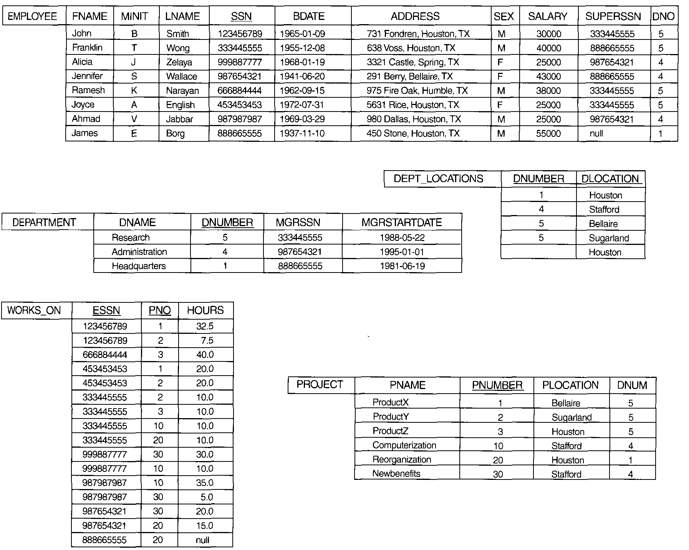

Slide 5
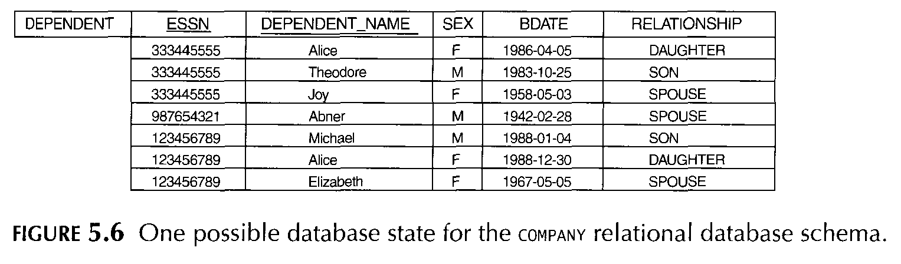

Slide 6
UNARY RELATIONAL OPERATIONS:SELECT AND PROJECT
The select operation:
The SELECT operation is used to select a subset of the tuples from a relation that satisfy a selection condition
It keeps only those tuples that satisfy a qualifying condition
The SELECT operation can also be visualized as a horizontal partition of the relation into two sets of tuples-those tuples that satisfy the condition and are selected, and those tuples that do not satisfy the condition and are discarded.

Slide 7
example1: to select the EMPLOYEE tuples whose department is 4, or those whose salary is greater than $30,000, we specify with SELECT as
σDNO=4 (EMPLOYEE) OR σ SALARY>30000(EMPLOYEE)
Example 2: to select the tuples for all employees who either work in department 4 and make over $25,000 per year, or work in department 5 and make over $30,000, we can specify the following SELECT operation:
σ(DNO=4 AND SALARY>25000) OR (DNO=5 AND SALARY> 30000)(EMPLOYEE)

Slide 8
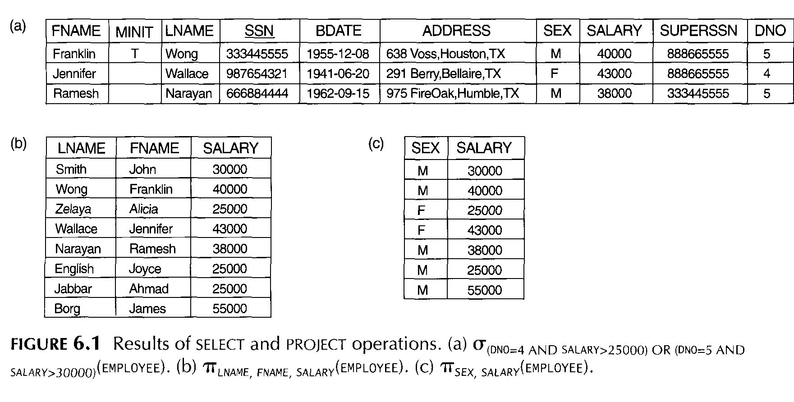

Slide 9
In general, the SELECT operation is denoted by σ<selection condition>(R),
where the symbol σ (sigma) is used to denote the SELECT operator, and the selection condition is a Boolean expression specified on the attributes of relation R.
The relation resulting from the SELECT operation has the same attributes as R
The Boolean expression specified in <selection condition> is made up of a number of clauses of the form :
<attribute name> <comparison op> <constant value>,
where <attribute name> is the name of an attribute of R, <comparison op> is normally one of the operators {=, <=, >=)}, and <constant value> is a constant value from the attribute domain.

Slide 10
Clauses can be arbitrarily connected by the Boolean operators AND, OR, and NOT to form a general selection condition
For example
To select the tuples for all employees who either work in department 4 and make over $25,000 per year, or work in department 5 and make over $30,000, we can specify the following SELECT operation: σ (DNO=4 AND SALARY>25000) OR (DNO=5 AND SALARY>30000)(EMPLOYEE)
In general, the result of a SELECT operation can be determined as follows.

Slide 11
The <selection condition> is applied independently to each tuple t in R.
This is done by substituting each occurrence of an attribute Ai in the selection condition with its value in the tuple t[Ai].
If the condition evaluates to TRUE, then tuple t is selected.
All the selected tuples appear in the result of the SELECT operation.

Slide 12
The Boolean conditions AND, OR, and NOT have their normal interpretation, as follows:
(condl AND cond2) is TRUE if both (cond l ) and (cond2) are TRUE; otherwise, it is FALSE.
(cond l OR cond2) is TRUE if either (cond l ) or (cond2) or both are TRUE; otherwise, it is FALSE.
(NOT cond) is TRUE if cond is FALSE; otherwise, it is FALSE.
The SELECT operator is unary; that is, it is applied to a single relation
The degree of the relation resulting from a SELECT operation-its number of attributes-is the same as the degree of R.
The number of tuples in the resulting relation is always less than or equal to the number of tuples in R
Notice that the SELECT operation is commutative; that is,
σ <cond1>(σ <cond2>(R)) = σ<cond2>(σ <cond1>(R))

Slide 13
The project operation
the SELECT operation selects some of the rows from the table while discarding other rows.
The PROJECT operation, on the other hand, selects certain columns from the table and discards the other columns
If we are interested in only certain attributes of a relation, we use the PROJECT operation to project the relation over these attributes only
The result of the PROJECT operation can hence be visualized as a vertical partition of the relation into two relations: one has the needed columns (attributes) and contains the result of the operation, and the other contains the discarded columns.
For example, to list each employee's first and last name and salary, we can use the PROJECT operation as follows:
∏LNAME, FNAME, SALARY( EMPLOYEE)

Slide 14
The general form of the PROJECT operation is
∏<attribute list> (R)
where ∏ (pi) is the symbol used to represent the PROJECT operation, and <attribute list> is the desired list of attributes from the attributes of relation R
The result of the PROJECT operation has only the attributes specified in <attribute list> in the same order as they appear in the list.
Hence, its degree is equal to the number of attributes in <attribute list>.
The number of tuples in a relation resulting from a PROJECT operation is always less than or equal to the number of tuples in R.
In projection ∏<Iist1 > (∏<list2>)) = ∏ <list1>(R) as long as <Iist 2> contains the attributes in <list1 >; otherwise, the left-hand side is an incorrect expression
commutatively does not hold on PROJECT

Slide 15
Sequences of Operations and the RENAME Operation
we may want to apply several relational algebra operations one after the other.
Either we can write the operations as a single relational algebra expression by nesting the operations, or we can apply one operation at a time and create intermediate result relations.
In the case of intermediate result , we must give names to the relations that hold the intermediate results.
For example: to retrieve the first name, last name, and salary of all employees who work in department number 5, we must apply a SELECT and a PROJECT operation.
We can write a single relational algebra expression as follows:
∏ FNAME, LNAME, SALARY(σDNO=5 (EMPLOYEE))

Slide 16
Alternatively, we can explicitly show the sequence of operations, giving a name to each intermediate relation
DEP5_EMPS← σDNO=5 (EMPLOYEE)
RESULT←∏ FNAME, LNAME,SALARY (DEP5_EMPS)
Note:
It is often simpler to break down a complex sequence of operations by specifying intermediate result relations than to write a single relational algebra expression

Slide 17
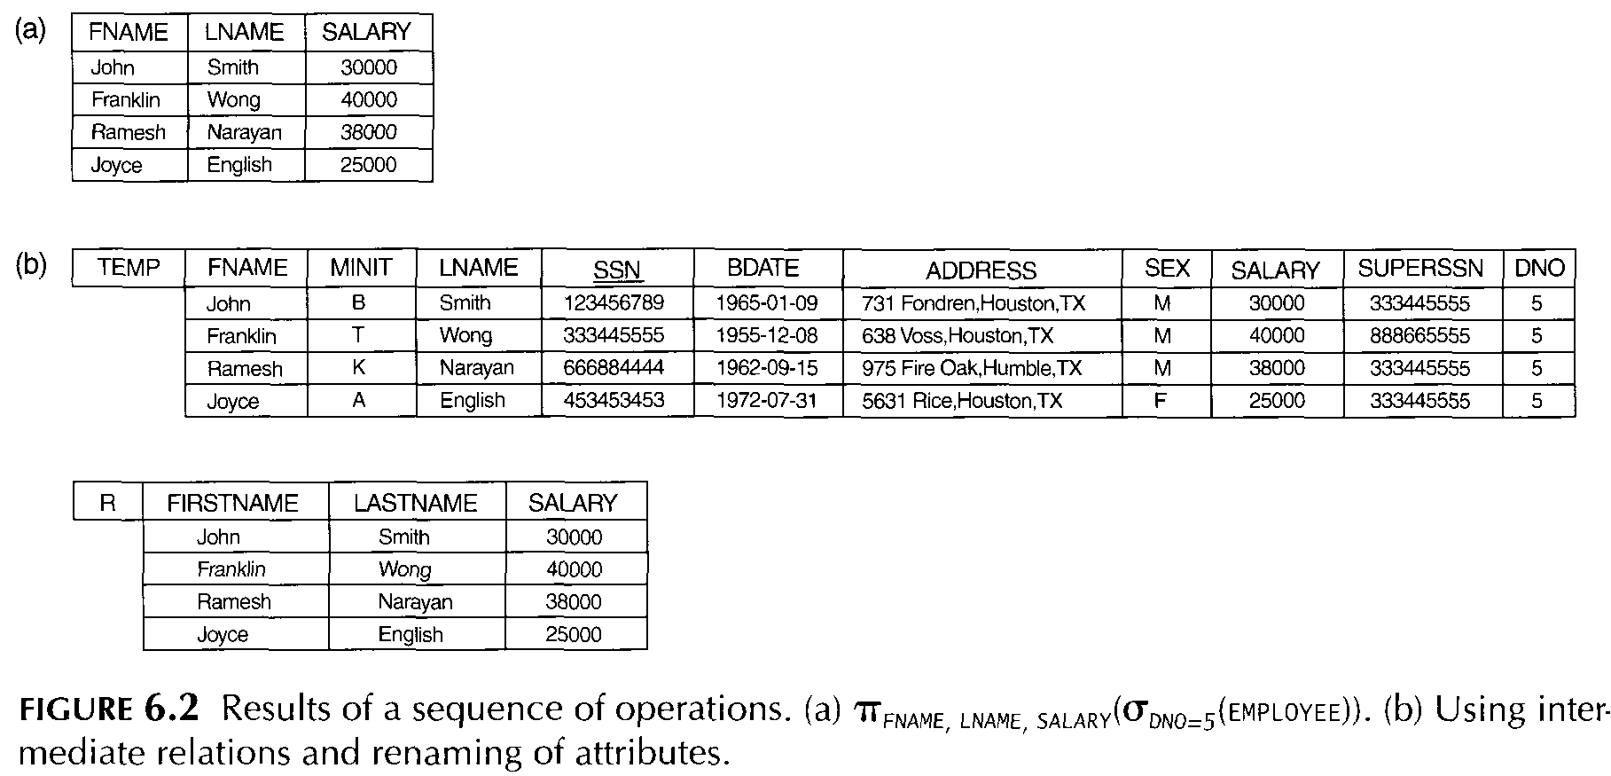

Slide 18
RELATIONAL ALGEBRA OPERATIONS FROM SET THEORY
The UNION, INTERSECTION, and MINUS Operations
These are standard mathematical operations on sets
When these operations are adapted to relational databases, the two relations on which any of these three operations are applied must have the same type of tuples;
This condition has been called union compatibility.
Two relations R(A1, Az, ... , An) and S(B 1, Bz, ... , Bn) are said to be union compatible if they have the same degree n and if dom(Ai) = dom(Bi) for 1 <i<=n
This means that the two relations have the same number of attributes, and each corresponding pair of attributes has the same domain.

Slide 19
UNION
The result of this operation, denoted by R U S, is a relation that includes all tuples that are either in R or in S or in both R and S. Duplicate tuples are eliminated.
For example:
to retrieve the social security numbers of all employees who either work in department 5 or directly supervise an employee who works in department 5, we can use the UNION operation as follows:
DEP5_EMPS←σDNO=5 (EMPLOYEE)
RESULT1←∏SSN (DEP5_EMPS)
RESULT2 (SSN)← ∏SUPERSSN (DEP5_EMPS)
RESULT← RESULT1 U RESULT2

Slide 20
The relation RESULT1 has the social security numbers of all employees who work in department 5,
whereas RESULT2 has the social security numbers of all employees who directly supervise an employee who works in department 5.
The UNION operation produces the tuples that are in either RESULT1 or RESULT2 or both.
Note that the SSN value 333445555 appears only once in the result.

Slide 21
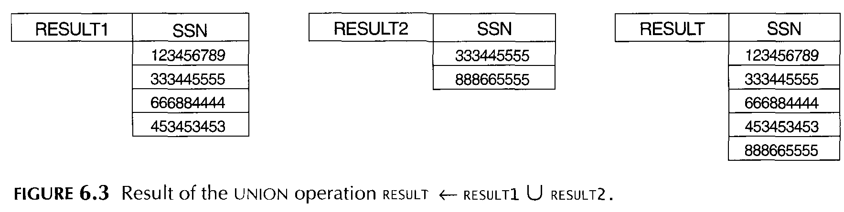

Slide 22
Intersection:
The result of this operation, denoted by R n S, is a relation that includes all tuples that are in both Rand S.
Set difference (or MINUS)
The result of this operation, denoted by R - S, is a relation that includes all tuples that are in R but not in S.
Figure 6,4 illustrates the three operations.
The relations STUDENT and INSTRUCTOR in Figure 6,4a are union compatible, and their tuples represent the names of students and instructors, respectively.
The result of the UNION operation in Figure 6,4b shows the names of all students and instructors.
Note that duplicate tuples appear only once in the result. The result of the INTERSECTION operation (Figure 6,4c) includes only those who are both students and instructors.

Slide 23
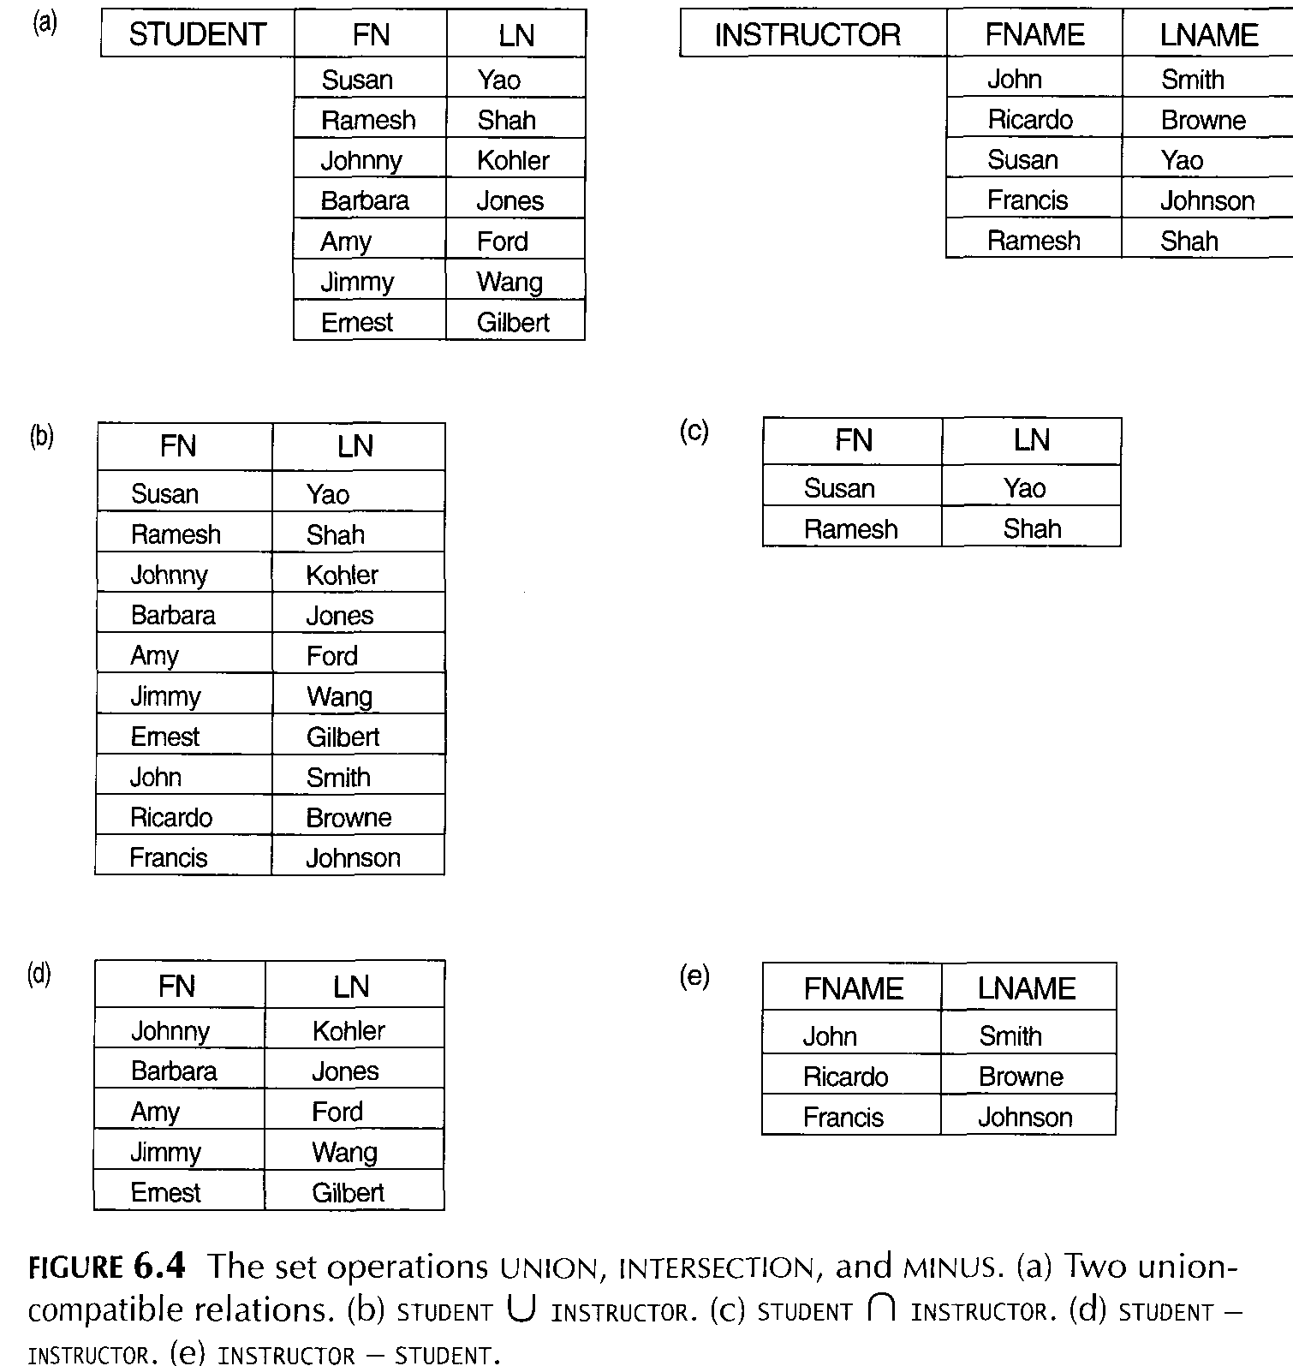

Slide 24
The Cartesian Product
The CARTESIAN PRODUCT operation-also known as CROSS PRODUCT or CROSS JOIN-which is denoted by x
This operation is used to combine tuples from two relations in a combinatorial fashion.
In general, the result of R(A j , Az, ... , An) X S(Bj , Bz, ... , Bm) is a relation Q with degree n + m attributes Q(Aj , Az' ... , An' Bj , Bz, ... , Bm), in that order
The resulting relation Q has one tuple for each combination of tuples-one from R and one from S.
Hence, if R has nR tuples (denoted as IRI = nR ), and S has ns tuples, then Rx S will have nR * ns tuples.

Slide 25
For example, suppose that we want to retrieve a list of names of each female employee's dependents
FEMALE_EMPS←σSEX=' F' (EMPLOYEE)
EMPNAMES←∏FNAME, LNAME, SSN (FEMALE_EMPS)
EMP_DEPENDENTS←EMPNAMES X DEPENDENT
ACTUAL_DEPENDENTS←σSSN=ESSN (EMP_DEPENDENTS)
RESULT←∏FNAME, LNAME, DEPENDENLNAME (ACTUAL_DEPENDENTS)
In EMP_DEPENDENTS, every tuple from EMPNAMES is combined with every tuple from DEPENDENT, giving a result that is not very meaningful
We want to combine a female employee tuple only with her particular dependents-namely, the DEPENDENT tuples whose ESSN values match the SSN value of the EMPLOYEE tuple
The ACTUAL_DEPENDENTS relation accomplishes this.

Slide 26
BINARY RELATIONAL OPERATIONS
The JOIN Operation
The JOIN operation, denoted by Ɣ , is used to combine related tuples from two relations into single tuples
it allows us to process relationships among relations.
Example: suppose that we want to retrieve the name of the manager of each department
To get the manager's name, we need to combine each department tuple with the employee tuple whose SSN value matches the MGRSSN value in the department tuple
We do this by using the JOIN operation, and then projecting the result over the necessary attributes, as follows
DEPT_MGR← DEPARTMENT Ɣ MGRSSN=SSN EMPLOYEE
RESULT←∏DNAME, LNAME, FNAME (DEPT_MGR)
Note: that MGRSSN is a foreign key and that the referential integrity constraint plays a role in having matching tuples in the referenced relation Employee.

Slide 27
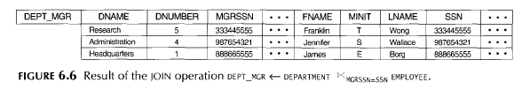
The result of the JOIN is a relation Q with n + m attributes Q(AI, Az, ... , An' BI, B2, ... , Bm ) in that order; Q has one tuple for each combination of tuples-one from R and one from S-whenever the combination satisfies the join condition
In JOIN, only combinations of tuples satisfying the join condition appear in the result, whereas in the CARTESIAN PRODUCT all combinations of tuples are included in the result
This is the main difference between CARTESIAN PRODUCT and JOIN.
Each tuple combination for which the join condition evaluates to TRUE is included in the resulting relation Q as a single combined tuple

Slide 28
Assigment Two
Prepare a short note with examples and scenarios on the following topics. Also use sample queries to demonstrate each of the topics. Here are the topics
Graph database
MongoDB
Postgress database
Inner join
Full Outer join
Left join
Right Join

